Slide 1
CPEN 211 Database Systems Design Introduction
Notes:
1

Slide 2
Data vs. Information
Data:
Raw facts; building blocks of information
Unprocessed information
Information:
Data processed to reveal meaning
Accurate, relevant, and timely information is key to good decision making
Good decision making is key to survival in global environment

Slide 3
Introducing the Database and the DBMS
Database—shared, integrated computer structure that houses:
End user data (raw facts)
Metadata (data about data)

Slide 4
Introducing the Database and the DBMS (continued)
DBMS (database management system):
Collection of programs that manages database structure and controls access to data
Possible to share data among multiple applications or users
Makes data management more efficient and effective

Slide 5
What is a DBMS?
Database Management System (DBMS) = data + set of instructions to access/manipulate data
Features of a DBMS
Support massive amounts of data
Persistent storage
Efficient and convenient access
Secure, concurrent, and atomic access
Examples?
Search engines, banking systems, airline reservations, corporate records, payrolls, sales inventories.
New applications: Wikis, biological/multimedia/scientific/geographic data, heterogeneous data.
Notes:
5

Slide 6
Features of a DBMS
Support massive amounts of data
Giga/tera/petabytes
Far too big for main memory
Persistent storage
Programs update, query, manipulate data.
Data continues to live long after program finishes.
Efficient and convenient access
Efficient: do not search entire database to answer a query.
Convenient: allow users to query the data as easily as possible.
Secure, concurrent, and atomic access
Allow multiple users to access database simultaneously.
Allow a user access to only to authorized data.
Provide some guarantee of reliability against system failures.
Notes:
6

Slide 7
Types of Databases
Single-user:
Supports only one user at a time
Multi-user:
Supports multiple users at the same time

Slide 8
Location of Databases
Centralized:
Supports data located at a single site
Distributed:
Supports data distributed across several sites

Slide 9
Uses of Databases
Transactional (or production):
Supports a company’s day-to-day operations
Data warehouse:
Stores data used to generate information required to make tactical or strategic decisions
Such decisions typically require “data massaging”
Often used to store historical data
Structure is quite different

Slide 10
A Brief History of DBMS
The earliest databases (1960s) evolved from file systems
File systems
Allow storage of large amounts of data over a long period of time
File systems do not support:
Efficient access of data items whose location in a particular file is not known
Logical structure of data is limited to creation of directory structures
Concurrent access: Multiple users modifying a single file generate non-uniform results
Navigational and hierarchical
User programmed the queries by walking from node to node in the DBMS.
Relational DBMS (1970s to now)
View database in terms of relations or tables
High-level query and definition languages such as SQL
Allow user to specify what (s)he wants, not how to get what (s)he wants
Object-oriented DBMS (1980s)
Inspired by object-oriented languages
Object-relational DBMS
Notes:
10

Slide 11
The Historical Roots of Database: Files and File Systems
Although managing data through file systems is largely obsolete
Understanding relatively simple characteristics of file systems makes complexity of database design easier to understand.
Awareness of problems that plagued file systems can help prevent similar problems in DBMS.
Knowledge of file systems is helpful if you plan to convert an obsolete file system to a DBMS.

Slide 12
1-Manual File Systems
Traditionally composed of collection of file folders kept in file cabinet
Organization within folders was based on data’s expected use (ideally logically related)
System was adequate for small amounts of data with few reporting requirements
Finding and using data in growing collections of file folders became time-consuming and cumbersome

Slide 13
2-Computer File System
Could be technically complex, requiring hiring of data processing (DP) specialists
DP specialists created file structures, wrote software, and designed application programs
Resulted in numerous “home-grown” systems being created.
Initially, computer files were similar in design to manual files

Slide 14
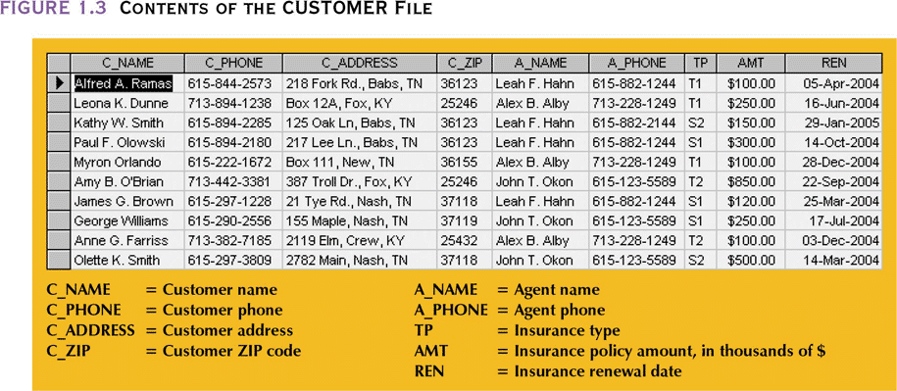
Contents of Customer File

Slide 15
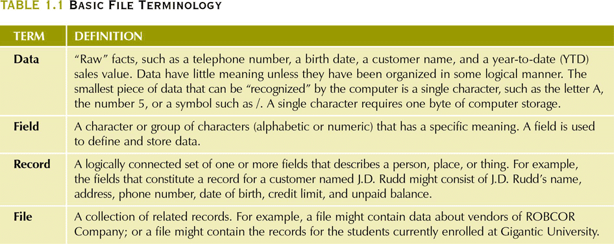
Basic File Terminology

Slide 16
3- Early Database Design
DP specialist wrote programs for reports:
Monthly summaries of types and amounts of insurance sold by agents
Monthly reports about which customers should be contacted for renewal
Reports that analyzed ratios of insurance types sold by agent
Customer contact letters summarizing coverage
Additional reports were written as required

Slide 17
Why Study Databases?
Academic
Databases involve many aspects of computer science
Fertile area of research
Three Turing awards in databases
Programmer
a plethora of applications involve using and accessing databases
Businessman
Everybody needs databases => lots of money to be made
Student
Get those last three credits and I don’t have to come back to Blacksburg ever again!!!
Google, Oracle, Microsoft, etc. will hire me!!
Databases sound cool!
???
Notes:
17

Slide 18
What Will You Learn in this course?
Implementation
How do you build a system such as ORACLE or MySQL?
Design
How do you model your data and structure your information in a database?
Programming
How do you use the capabilities of a DBMS?
This course achieves a balance between
a firm theoretical foundation to designing moderate-sized databases
creating, querying, and implementing realistic databases and connecting them to applications
Notes:
18

Slide 19
The DBMS Industry
A DBMS is a software system.
Major DBMS vendors: Oracle, Microsoft, IBM, Sybase
Free/Open-source DBMS: MySQL, PostgreSQL, Firebird.
Used by companies such as Google, Yahoo, Lycos, BASF.
All are “relational” (or “object-relational”) DBMS.
Notes:
19

Slide 20
Course Goals and Outcomes
Take an English language description and convert it into a working database application.
Create E/R models from application descriptions.
Convert E/R models into relational designs.
Identify redundancies in designs and remove them using normalization techniques.
Create databases in an RDBMS and enforce data integrity constraints using SQL.
Write sophisticated database queries using SQL.
Understand tradeoffs between different ways of phrasing the same query.
Implement a web interface to a database.
Notes:
20

